Slide 1

Wilson Golf:
Modular Golf Kit
Research Deck
By:
Zair Chaudhry, Daecheol Jeong,
Muhammad Ijlal, Ralph Estephan, David Yi

Slide 2
Table of Contents
Problem Statement
Why Do This?
Skewed Information?
Practice
Custom Gear
Final Problem Statement
Target Audience
What’s important in a golf club
Grip
Shaft
Club Head
Loft
Prototypes
Sketch
Storyboard
Website

Slide 3
Problem Statement
We want to figure out why this problem is beneficial to solve?
Things Like Benefit, Concerns
We learned online information is skewed and unreliable.
Lack of Trusted Resources
We learned a lot of golfers feel a overwhelmed,frustrated,unsure about learning golf,practicing golf and customizing their golf equipment.
A lot of Data required in order to get proper fitting
This is because can not find or go to the proper resources to learn and practice
Not much helpful to learn and practice beside physical Coaching
These golfers also are unsure of the data needed to customize their golf equipment to fit their needs

Slide 4
Why Do This?
There are already many types of premade clubs
the user doesn’t know where to start When it comes to purchasing a golf club.
There are many golf clubs
the different types of clubs
each cater into different golf situations.
The players may find themselves in different situations
They have not found their particular style yet.
The player may not have their particular style in golf yet,
There are many different terrains and styles
Try to experiment with different situations.

Slide 5
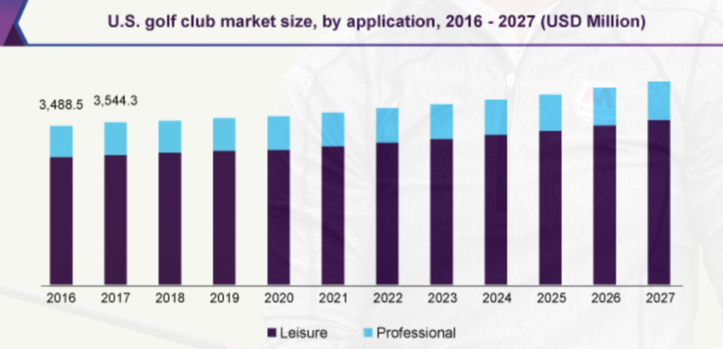
Target Audience
Leisure Players: most of the market is made of leisure players as seen in the graph previously, and this number is projected to grow through 2027.

Slide 6
Target Audience
This also ties in Leisure Players: most of the market is made of leisure players as seen in this graph below, and this number is projected to grow through 2027.
This also ties in with the interviews we did with several contacts, as they all play for leisure in their time. 9/12 of them do not use custom clubs, while 7/12 did not use custom fittings.
As previously mentioned with our interview, the players felt overwhelmed, frustrated, unsure about learning golf, practicing golf and customizing their golf equipment.
While guiding them to what pro’s and other to what other players generally like may not be the perfect solution, it may be the starting point and give them a direction on to where to go.

Slide 7
Grip
Only point of contact between the player and the club. Therefore, it has be just right so that the player can have the perfect amount of control.
Grip thickness has to be right
Thin grip can lead to too much hand action which can lead to unwantable actions such as too much power.
Thick grip would restrict hands from control of the club.
How can I tell which one is the right one?
“The proper grip should let you hold the club using your middle and ring fingers of your left hand with very little touching the pad with the thumb. If your finger doesn’t touch your thumb, it’s a sign that the grip is too big.”

Slide 8
Shaft
This is used for the player's height/size.
The taller the player, the bigger the shaft, and vice versa.
Shaft flex affects players’ swing.
A shaft too stiff will cause the ball to fly a lower height and lose distance.
A shaft too soft will result in the ball ballooning and also lose distance.
How can I tell which is the perfect medium?
Stiff shaft would cause the ball to slice.
Soft shaft would make the ball fly to the left.

Slide 9
Club Head
There are three different sizes of club heads: Oversized, Standards, and Midsized:
Oversized are the most forgiving as they give the most power out of the three. Downsides are that they are heavy and hard to control.
Standards are the smallest out of the three. They offer the more control and are lighter compared to the oversized. However by themselves, they lack power, making the user put in larger force for the ball distance to be greater compared to oversized.
Midsized are in between the oversized and standard sizing of the golf clubs. While they are a good middle between the two sizes, they do not offer an advantage of one side compared to the other.

Slide 10
Loft
The hosel is the part where the clubhead connects to the shaft, which affects the loft.
The loft is the angle formed by a line running down the center of the shaft and the face of the club. These two are connected because one affects the other.
Having a low angle or a low loft would make the ball have a larger distance traveled compared to a high loft.
A high loft in the meanwhile would cause the ball to fly higher and fall onto the ground in a steeper angle.
Which type of hosel should I look for?
It really depends on what purpose you need it for as there is no right and wrong answer compared to grips and shaft

Slide 11
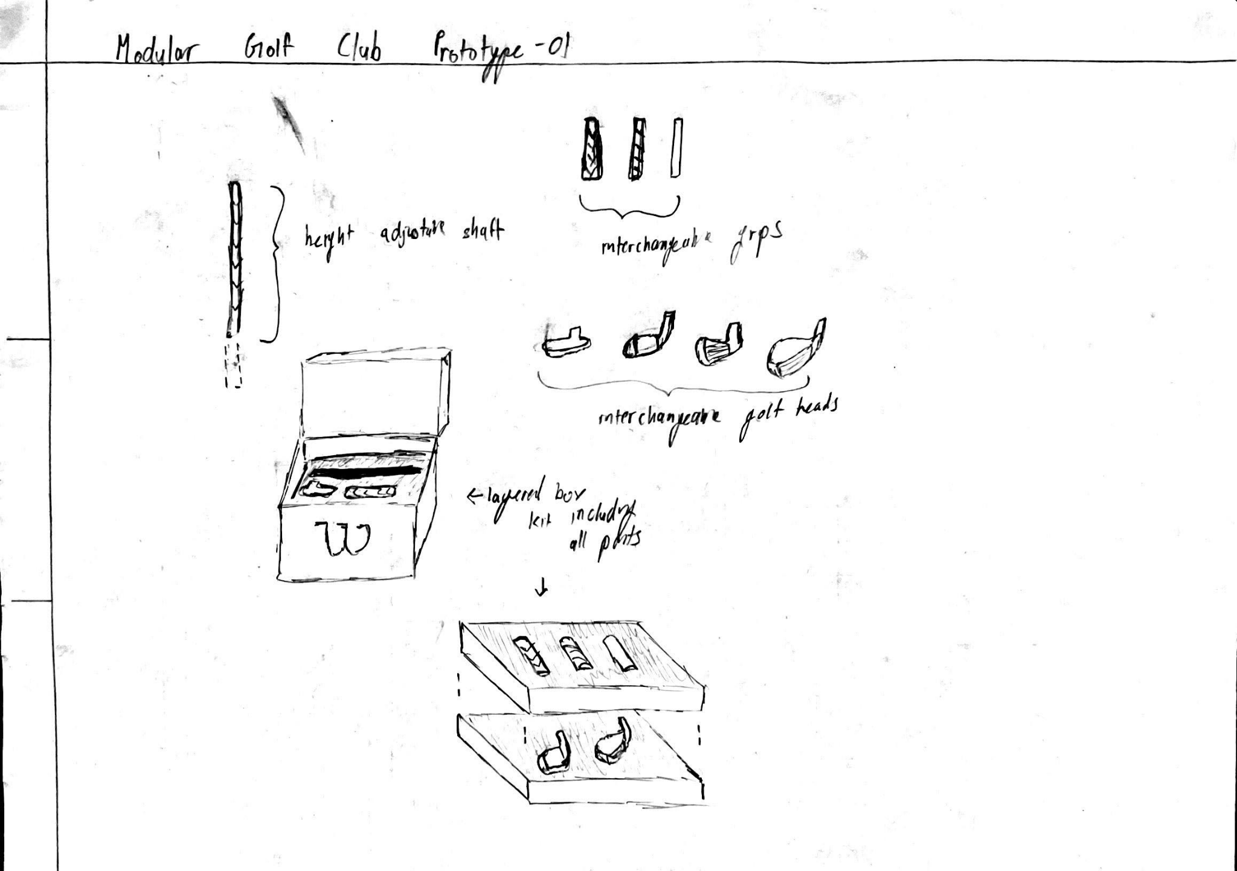
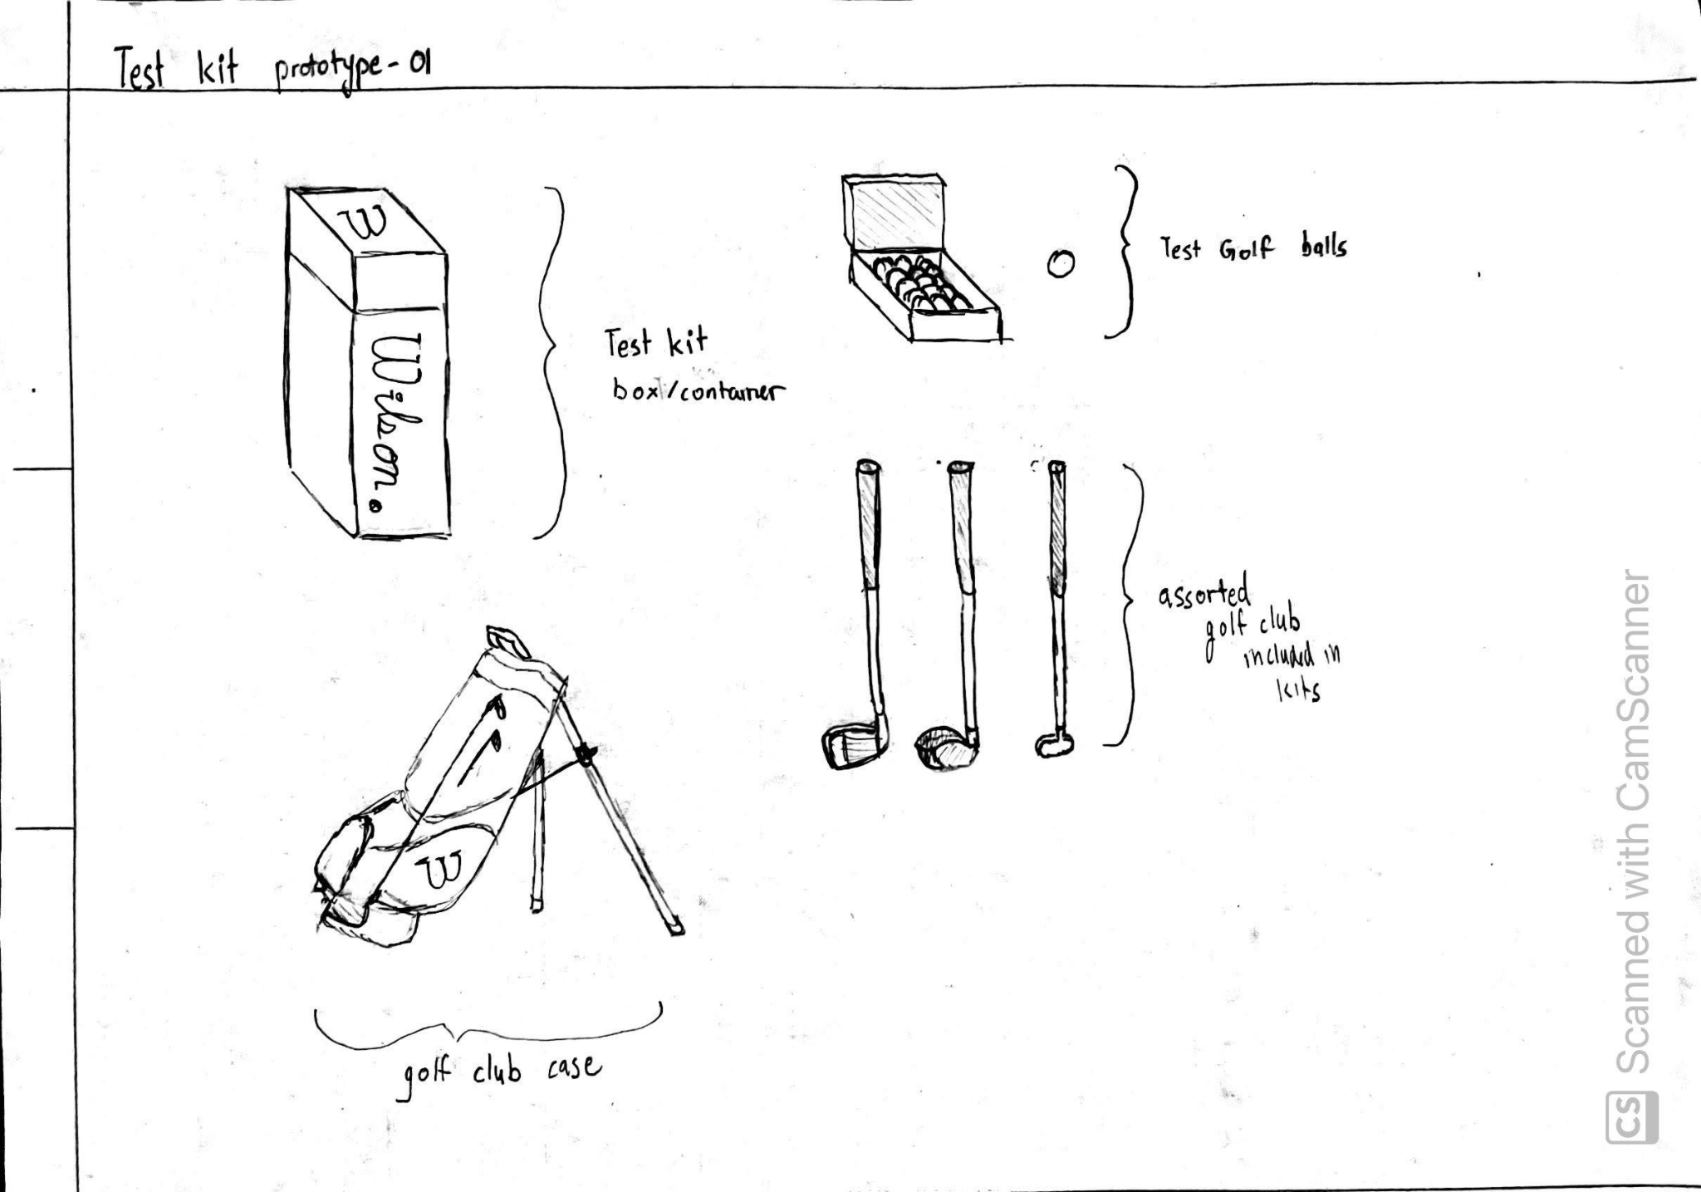
Prototype (Sketch)

Slide 12
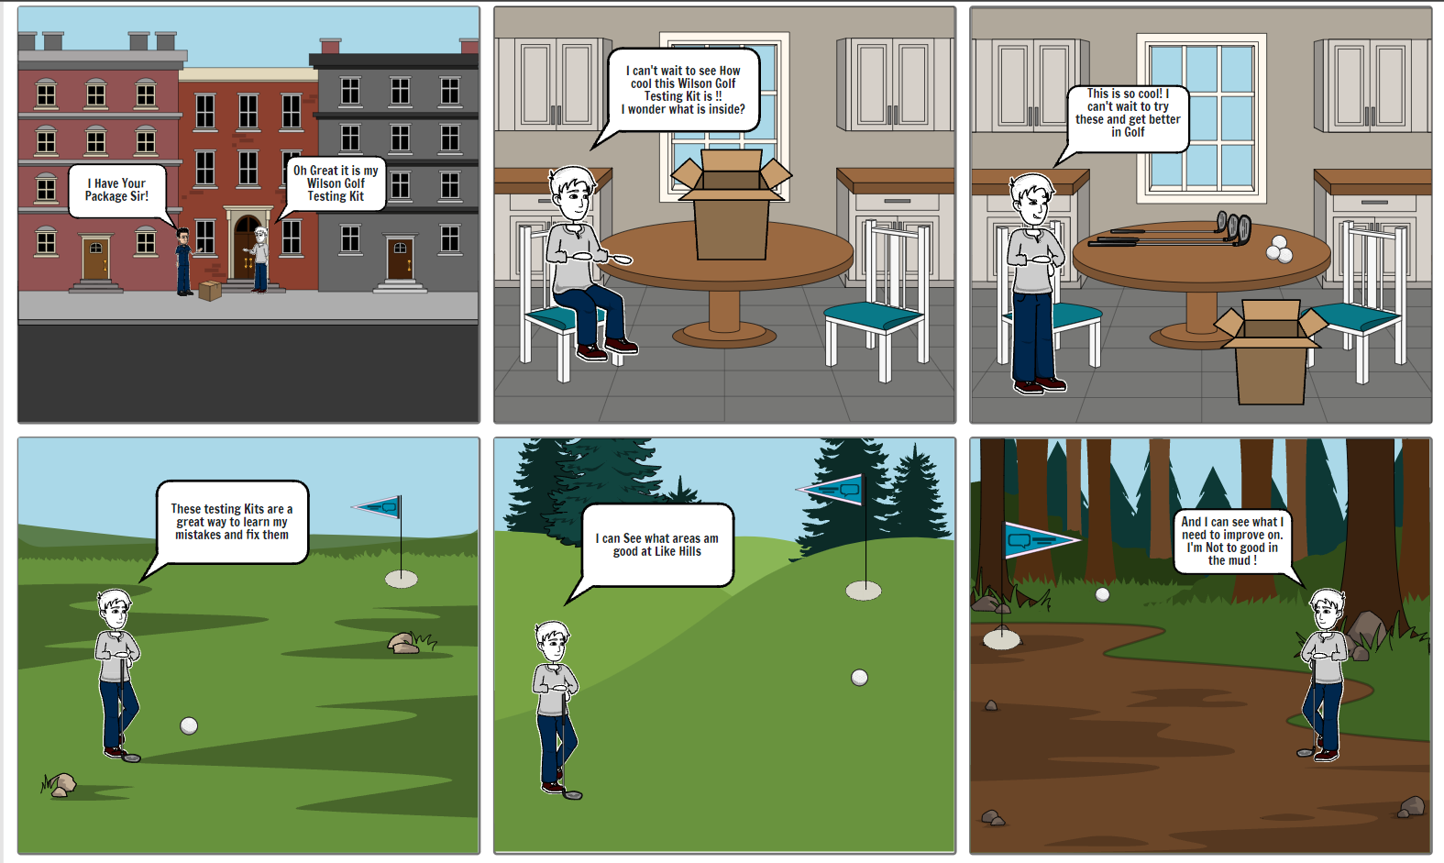
Prototype (Storyboard)

Slide 13
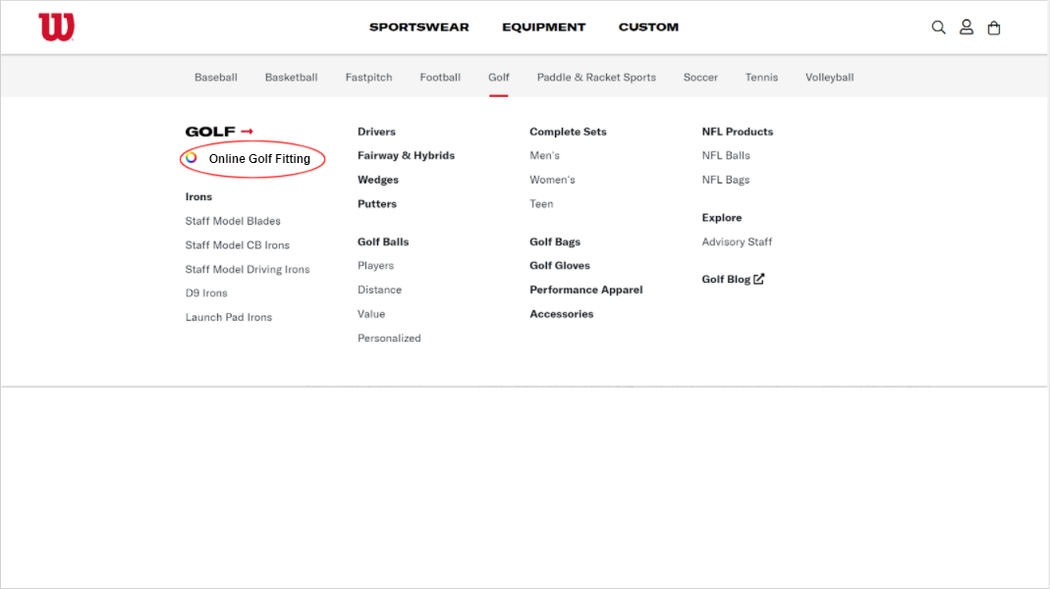
Prototype (Website)

Slide 14
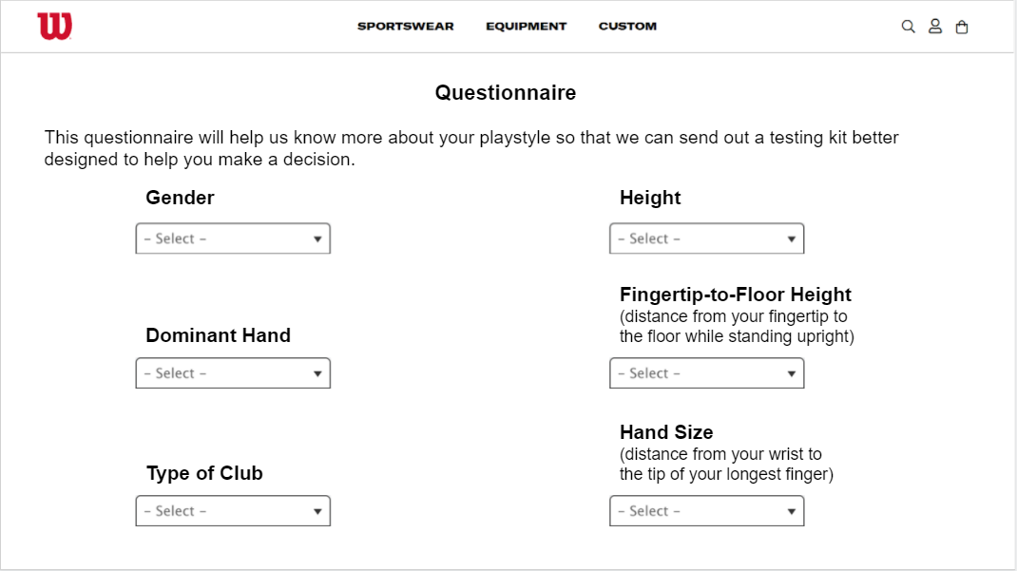
Prototype (Website)

Slide 15
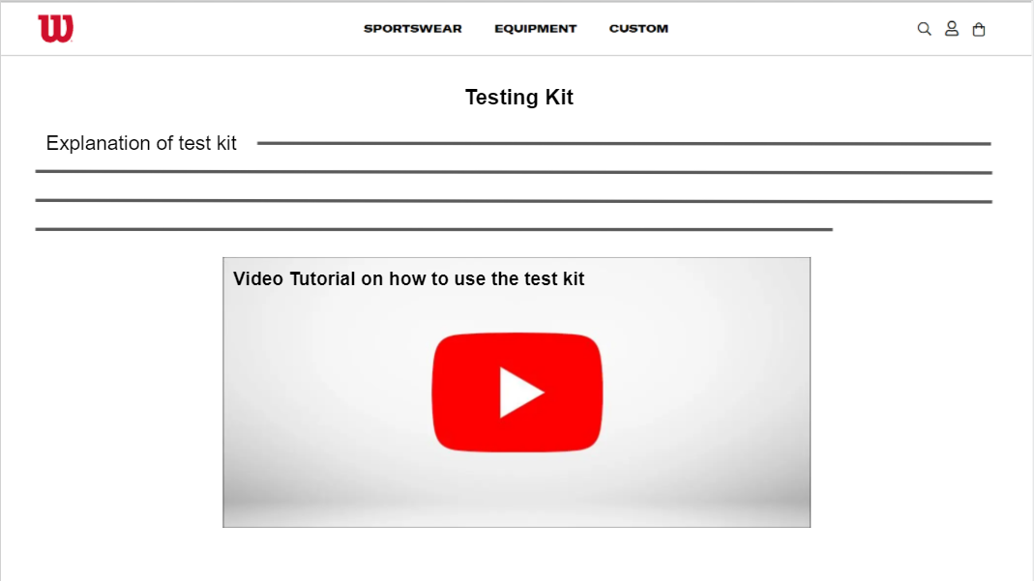
Prototype (Website)

Slide 16
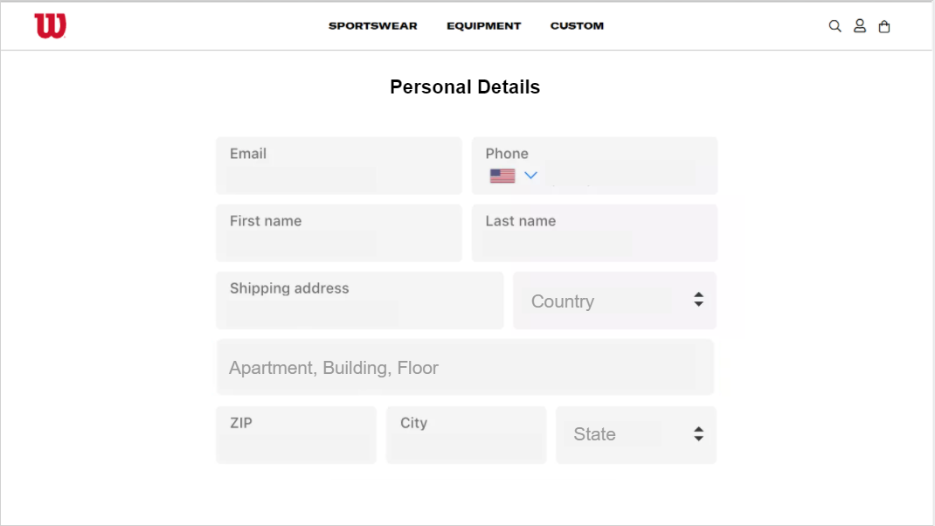
Prototype (Website)

